Slide 1
Rfid based door control system
Siddarth g l
Sudarshan dixith g m
Vivek b r
e.i.e 4th sem

Slide 2
What is rfid?
RFID is a acronym for “Radio frequency identification” and refers to a technology where by a digital data encoded in RFID tags or Smart labels are captured by a reader via radio waves.
RFID is similar to barcoding in the data from the tag or label are captured by a device that stores the data in a database

Slide 3
How does rfid work
RFID belongs to a group of technologies referred as a Automatic identification and data capture (AIDC). AIDC methods automatically identify objects , collect data about them, and enter those data directly into computer systems with little or no human intervention. RFID methods utilize radio waves to accomplish this. At a simple level ,RFID systems consists of three components: An RFID tag or smart label, an RFID reader and an antenna. RFID tags contain an integrated circuit and an antenna , which are used to transmit data to RFID reader The reader then converts the radio waves to a more usable form of communications interface to a host computer system, where the data can be stored in a database and analyzed at a later time

Slide 4
Components that are being used
Arduino UNO
5V relay module
12V Solenoid lock
RFID Sensor and tags
Buzzer
LEDs
Jumpers
5V battery for Arduino
12V Battery for Solenoid lock

Slide 5
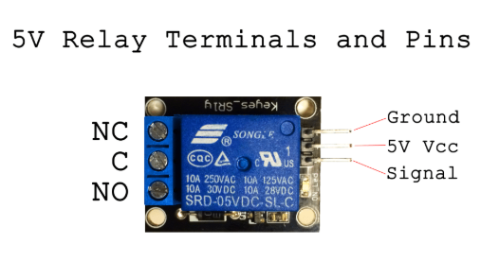
COMPONENT DESCRIPTION
5V RELAY MODULE
The SRD-05VDC-SL-C relay has three high voltage terminals (NC, C, and NO) which connect to the device you want to control. The other side has three low voltage pins (Ground, Vcc, and Signal) which connect to the Arduino.
Pin description of SRD-05VDC-SL-C is shown below

Slide 6
NC: Normally closed 120-240V terminal
NO: Normally open 120-240V terminal
C: Common terminal
Ground: Connects to the ground pin on the Arduino
5V Vcc: Connects the Arduino’s 5V pin
Signal: Carries the trigger signal from the Arduino that activates the relay
Inside the relay is a 120-240V switch that’s connected to an electromagnet. When the relay receives a HIGH signal at the signal pin, the electromagnet becomes charged and moves the contacts of the switch open or closed.

Slide 7
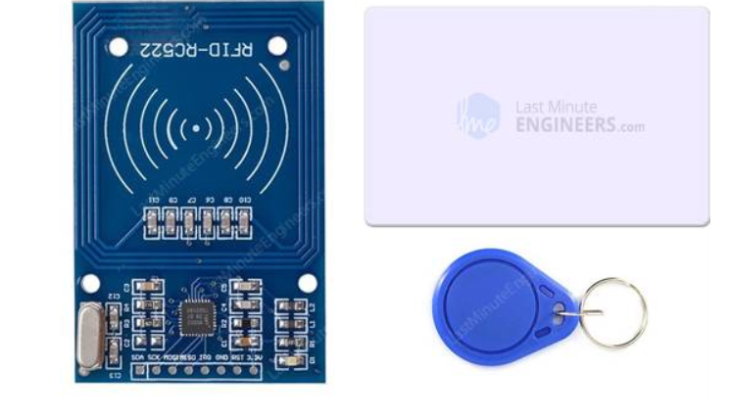
Rc522 rfid reader
The RC522 RFID Reader module is designed to create a 13.56MHz electromagnetic field that it uses to communicate with the RFID tags (ISO 14443A standard tags). The reader can communicate with a microcontroller over a 4-pin Serial Peripheral Interface (SPI) with a maximum data rate of 10Mbps. It also supports communication over I2C and UART protocols.
The operating voltage of the module is from 2.5 to 3.3V, but the interesting thing is that the logic pins are 5-volt tolerant, so we can easily connect it to an Arduino or any 5V logic microcontroller without using any logic level converter.

Slide 8
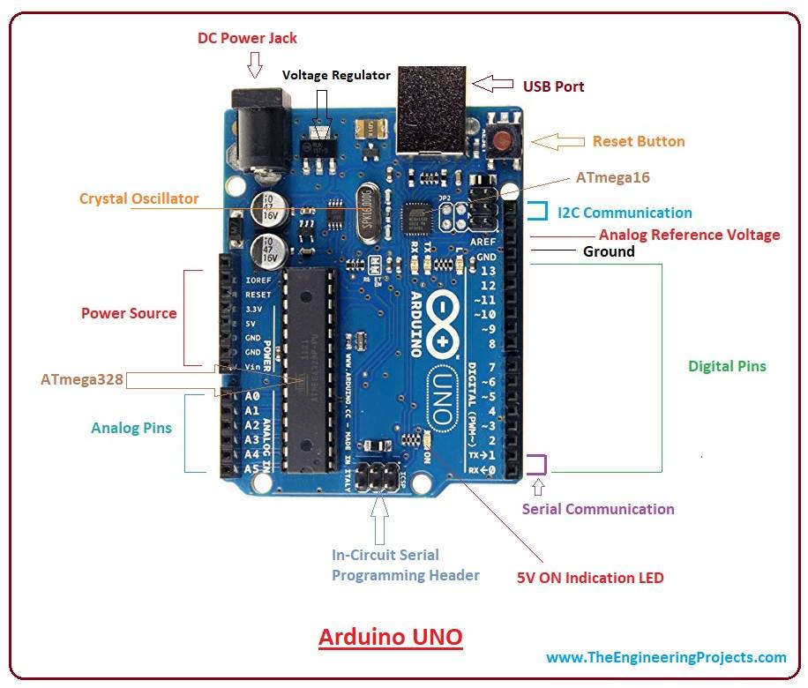
Arduino genuino/uno
Overview. The Arduino Uno is a microcontroller board based on the ATmega328. It has 20 digital input/output pins (of which 6 can be used as PWM outputs and 6 can be used as analog inputs), a 16 MHz resonator, a USB connection , a power jack, an in-circuit system programming (ICSP) header, and a reset button.

Slide 9
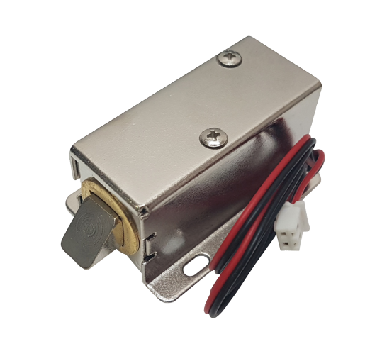
12v solenoid lock
12V Solenoid lock are basically electromagnets, they are made of a big coil of copper wire with an armature (a slug of metal) in the middle. When the coil is energized, the slug is pulled into the center of the coil. This makes the solenoid able to pull from one end.
This solenoid lock in particular is nice and strong, and has a slug with a slanted cut and a good mounting bracket. It’s basically an electronic lock, designed for a basic cabinet or safe or door. Normally the lock is active so you can’t open the door because the solenoid slug is in the way. It does not use any power in this state. When 9-12VDC is applied, the slug pulls in so it doesn’t stick out anymore and the door can be opened.
To drive a solenoid lock with an Arduino you will need a relay module fairly good power supply , as a lot of current will rush into the solenoid to charge up the electro-magnet, about 500mA, so don’t try to power it with a 9V battery!

Slide 10
Other components
JUMPER WIRES
These are used to join the individual components to Arduino via breadboard and to complete the circuit.
BUZZER AND L.E.Ds
Buzzer and LEDS are used as indicators to convey the status of the locking mechanism.
POWER SUPPLY
5V DC for Arduino and relay operation.
12V battery for operation of solenoid lock.

Slide 11
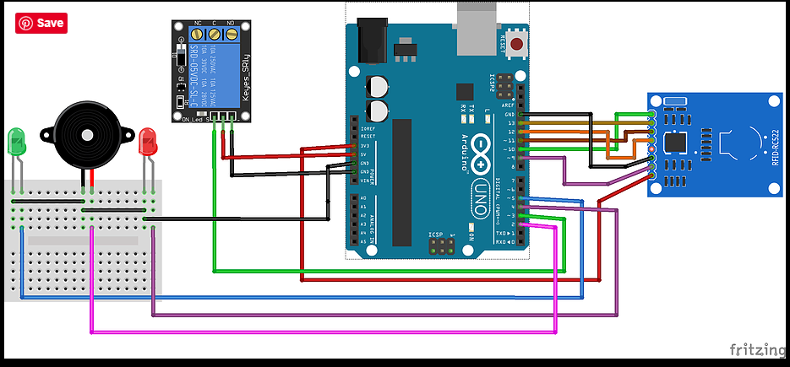
Circuit diagram

Slide 12
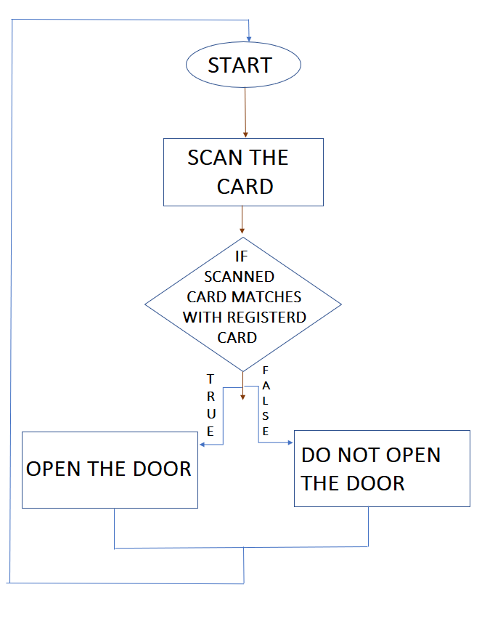
FLOW CHART

Slide 13
Advantages
RFID technology is versatile in nature and hence smaller and larger RFID devices are available as per application.
Tags can be read only as well as read/write unlike barcodes.
Unlike barcodes, tags can store more information. Moreover it follows instructions/commands of reader.
It is better than barcodes, as it cannot be easily replicated, and therefore, increases the security on a product.
Disadvantages
The coverage range of RFID is limited which is about 3 meters
The external electromagnetic interference can limit the RFID remote reading.
RFID devices need to be programmed which requires enough amount of time

Slide 14
Applications
RFID tags are very easy to install/inject inside the body of animals, thus helping to keep a track on them. This is useful in animal husbandry and the poultry industry, wherein the installed tags give information about the age, vaccinations, and health of the animal.
RFID tags are placed inside jewelry items in stores, and an alarm is installed at the exit doors. If an unauthorized attempt is made to move the jewelry items away from the premises, the alarm gets activated. This mechanism provides a much more robust type of security as compared to barcode scanners, as the barcode pattern is prone to being replicated.

Slide 15
THANK YOU

